Slide 1
How to be DJ with your Lap Top?!
Easy DJ Guide

Slide 2
It is so easy to be DJ
All you need is:
  Lap top
  DJ Software
  Headphone
  Tons of music in your itunes

Slide 3
Preferred Laptop
Macbook!! Because
they just want something to do the job needed to be done by a computer in a digital DJ set-up, something that does it with the minimum of fuss. Macs fit the bill, because OS X is often felt to be an easier operating system to use that Windows for non-expert users. With a Mac you are guaranteed a high standard of construction, and they have universal audio drivers so you don't need to mess around installing ASIO drivers to get your computer's sound card to work with them, as you have to for some hardware when using it with a PC. Macs are also pretty much free of computer viruses, unlike Windows.

Slide 4
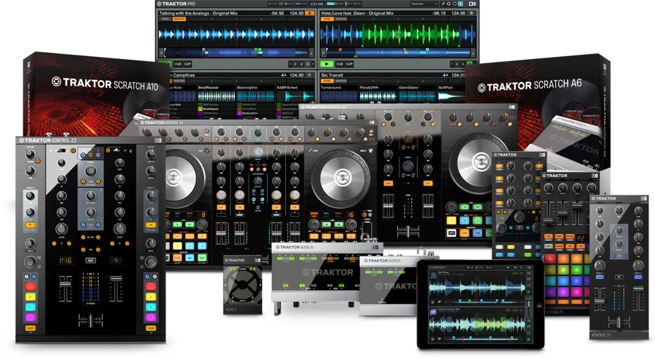
DJ Sofware
If you are into Any Music with 4/4 KICKS (eg. EDM, HOUSE and ETC)
  Go for Traktor by Native Instrument

Slide 5
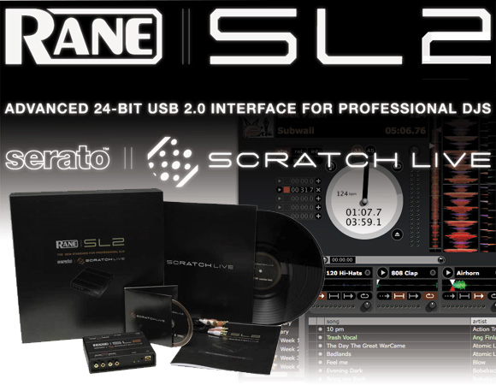
Dj Software
If you are into HIP HOP
  Go for Serato by Rane

Slide 6


You can also Get
What mixed in key do is :
Whether you are an aspiring or experienced DJ, Mixed In Key is an essential add-on to your DJ setup. This software virtually guarantees that your DJ sets will sound perfect.
The idea behind Mixed In Key is that it analyzes the harmonies and melodies of your music. It shows you the musical key of every track, and helps you choose tracks that are harmonically compatible with each other. The result is super-fluid mixing.

Slide 7
How to get a DJ Job in the Club?
Easy way
  Spend a lot of money at the club you love
  Get attention of Club PR peeps
  Get their contact and Tell them you are DJ
  That’s it
Normal Way
  Make mix tape
  Give away your mix CD to get attention
  Organize a party event
  Repeat till you get a job

Slide 8
When you get a DJ job
Make sure you target the right person
  From DJ Booth people who stands out in the whole club are:
      Group of people open a lot of BOTTLES!!!!!
  Logic behind this is:
    You need your club to make MONEY.
    Being good DJ is not making people dance make people eager to open bottles to have GOOD NIGHT

Slide 9
What is good mix?
If you spin in the club make sure:
  You don’t spend more than 3~4 mins per song.
    Because People get bored.
    But if the song is NEW make sure you play from beginning to End
  Structure your set List
    Smooth Transition is very important to keep the momentum
      you are playing “Shots” by LMFAO and you wouldn’t play “someone like you” by Alicia Keys

Slide 10
So what are you waiting for?
Go get the tools you need and have fun!!!!

